Slide 1

Sustainable Technology
Plant for Life
UTSA CS 3443 - 002
Spring 2020
(DAM_JH)
Leader Name: David Maestas
Github ID: davidmaestas13
abc123: xzu322
Name: Michael Ginsberg
Github ID: MichaelGinsberg
abc123: sfi208
Name: Aisha Bah
Github ID: Bianca2-be
abc123: ozg281
Name: Jasman Siduhu
Github ID: jman479
abc123: tqx609
Name: Hunter Long
Github ID: hunter-long
abc123: mia014

Slide 2
Plant for Life
Description
This application does the following; Tell the user what agriculture produce or crop (plant, vegetables, and fruit) can grow in a certain region, tell the user what type of soil that a particular region or area has, tell users how to efficiently grow a particular crop and tell the user what disease and pest are susceptible to that selected crop.
Pitch
We are in an era of opportunity in which sustainable technology solutions to world problems are required. The widespread adoption and use of technologies have the potential to provide new and innovative ways to solve issues involving hunger, drought, loss of species diversity, and water loss during crop production. Apps are being designed to address some of these issues.
Life as we know it would be impossible without plants as they play a major role in maintaining the atmosphere through the production of oxygen and absorption of carbon dioxide. The proposed sustainable technology app offers applications benefits for citizens in all geographical regions.
UTSA CS 3443 - 002
(DAM_JH) - Sustainable Technology Plant for Life

Slide 3
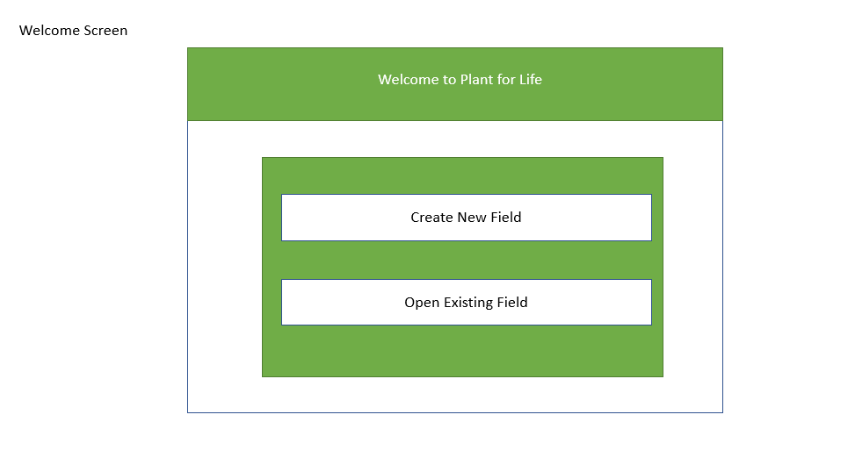
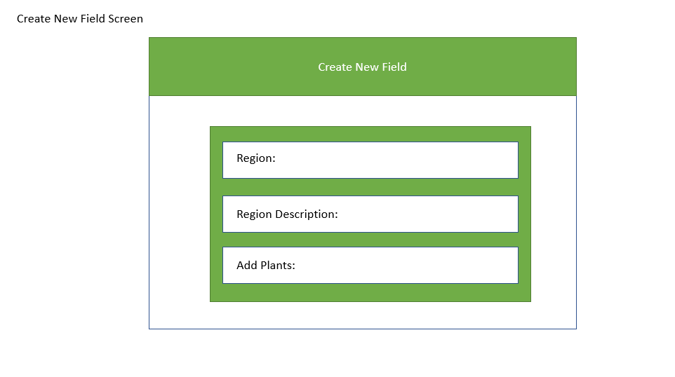
User Interface Design
Delete this text box and use this slide to visually show what the 1st two screens of your application might look like.
UTSA CS 3443 - 002
(DAM_JH) - Sustainable Technology Plant for Life

Slide 4
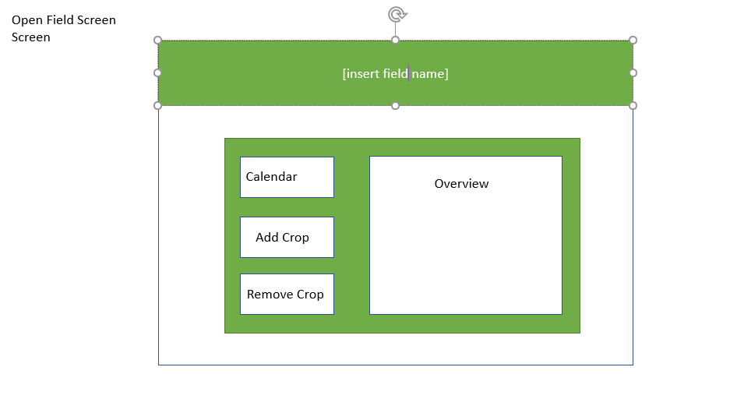
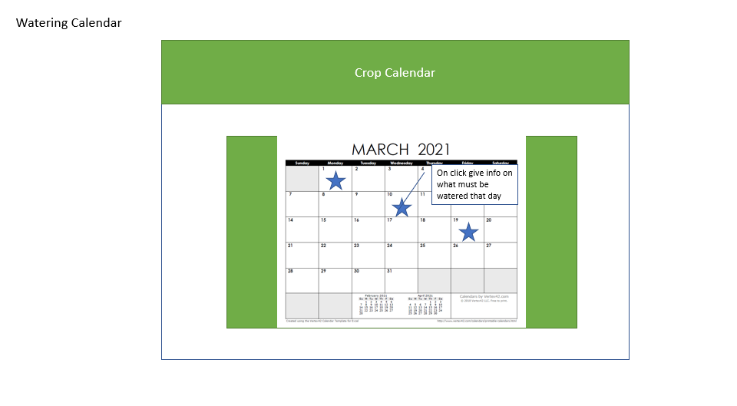
User Interface Design
Delete this text box and use this slide to visually show what the 3rd & 4th screens of your application might look like.
UTSA CS 3443 - 002
(DAM_JH) - Sustainable Technology Plant for Life

